Slide 1
Data Processing Pipeline
3/5/2021
5G-ELITE

Slide 2
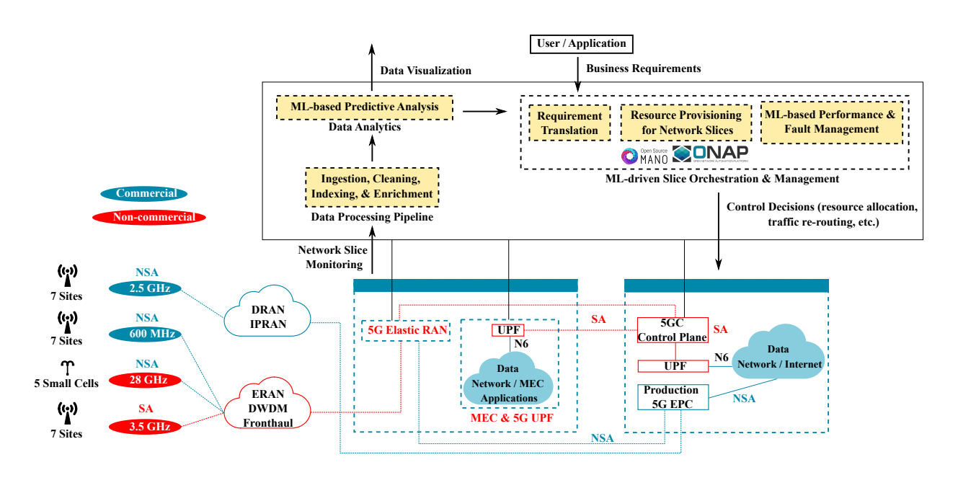
5G-Elite Architecture
Data Processing Pipeline
PAGE 2

Slide 3
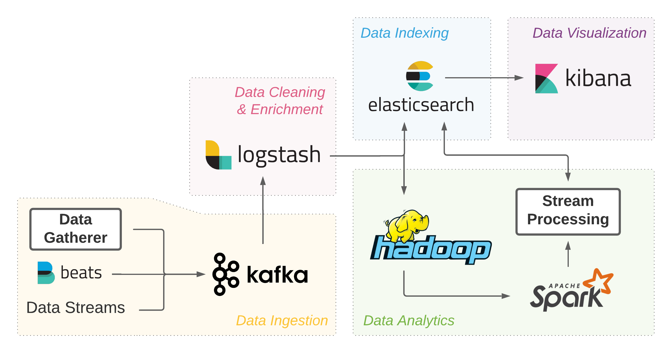
Data Processing Pipeline Software Stack
Data Processing Pipeline
PAGE 3

Slide 4
Data Sources
Data stream pushed to the pipeline by remote entities, e.g. performance measurements.
Data that is already available and could be fetched by the “Data Gatherer” module through requests, e.g. OpenStack measurements.
Data that needs to be extracted from remote servers using technologies such as Elastic Beats, e.g. link utilization.
Other data sources (e.g. SNMP MIBs).
Data Processing Pipeline
PAGE 4

Slide 5

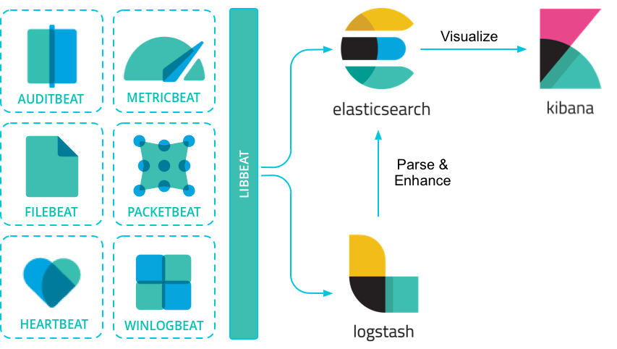
Elastic Beats
A collection of open-source data shippers to extract the operational data from remote servers, e.g. system/link resource usage.
Provides support for a variety of metrics, as well as the implementation of custom metrics.
https://www.elastic.co/guide/en/beats/libbeat/current/beats-reference.html
Data Processing Pipeline
PAGE 5

Slide 6

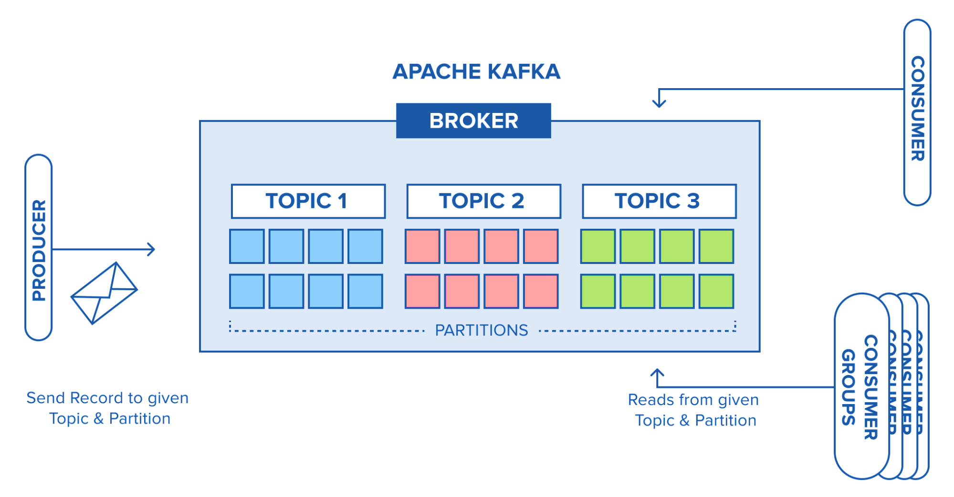
Apache Kafka
Open-source multi-producer, multi-consumer data queue.
Each type of data will be assigned to the specific topic to be processed by the respective data consumers (Logstash agents), e.g. each server will send data to its designated topic.
https://www.cloudkarafka.com/blog/2016-11-30-part1-kafka-for-beginners-what-is-apache-kafka.html
Data Processing Pipeline
PAGE 6

Slide 7

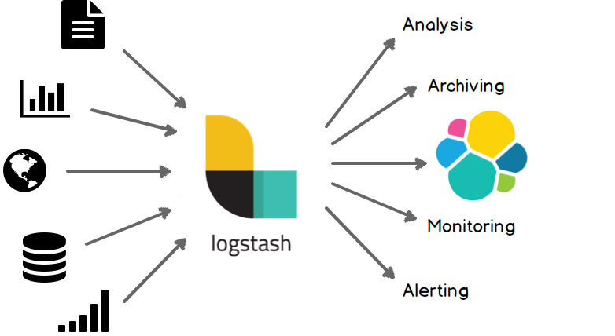
Logstash
Open-source data processing software to parse, filter, and transform data.
Unifies and normalizes data from a variety of types and sources to be further processed by Elasticsearch or Apache Spark.
https://www.elastic.co/guide/en/logstash/current/introduction.html
Data Processing Pipeline
PAGE 7

Slide 8

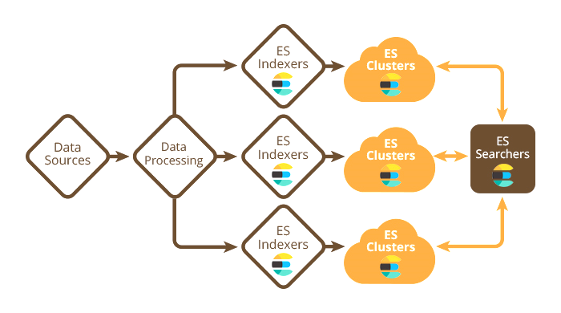
Elasticsearch
Text database that provides fast distributed search capabilities.
Integrates well with visualization (e.g. Kibana) and data processing (e.g. Apache Spark and Hadoop) technologies.
Provides the ability to store data for future use or retrieve historical data to be used in the analytics.
https://softwareengineeringdaily.com/2017/04/12/elasticsearch-with-philipp-krenn/
Data Processing Pipeline
PAGE 8

Slide 9

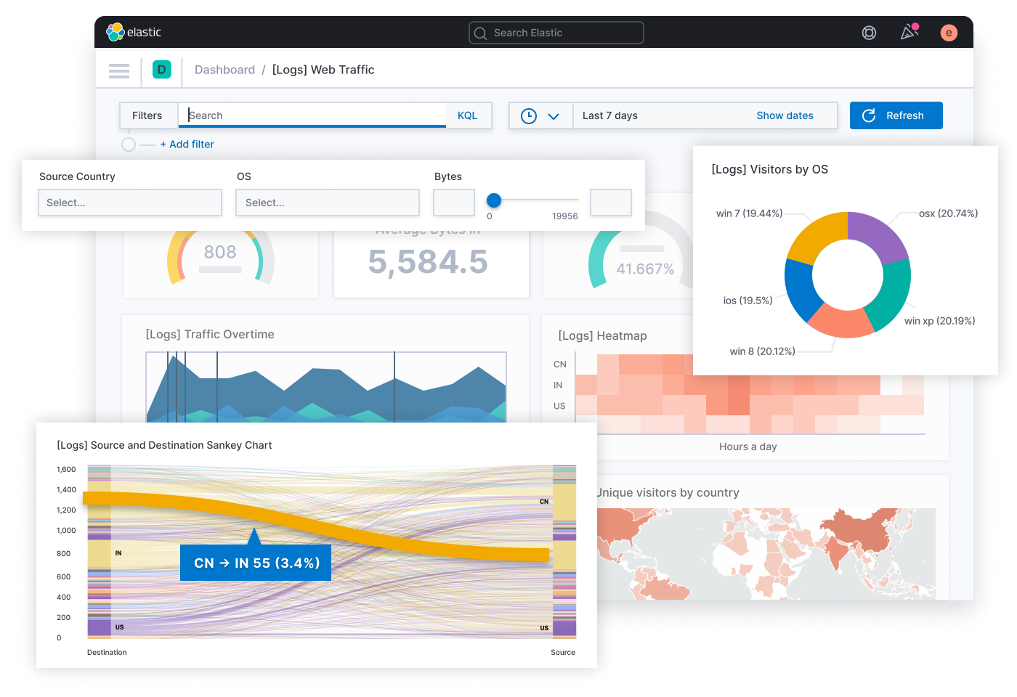
Kibana
Visualization tool that offers various types of data and metrics visualization.
https://www.elastic.co/kibana
Data Processing Pipeline
PAGE 9

Slide 10

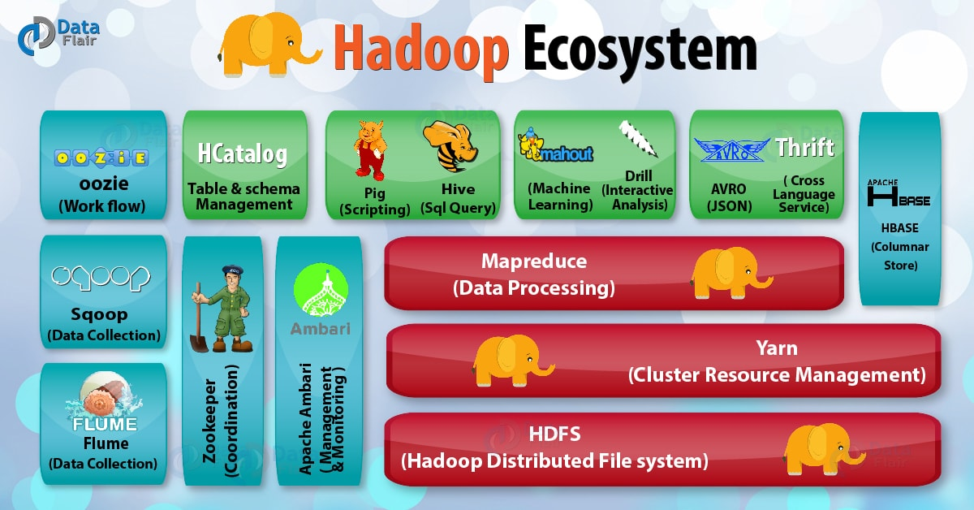
Apache Hadoop
A distributed ecosystem for managing and processing distributed data and software.
Manages the distributed resources and provides the ability to work with large scales of data across multiple servers.
Hadoop Distributed File System (HDFS) provides a unified storage system across multiple servers.
Hadoop YARN is responsible for resource allocation and task scheduling across the cluster.
https://data-flair.training/blogs/hadoop-ecosystem-components/
Data Processing Pipeline
PAGE 10

Slide 11

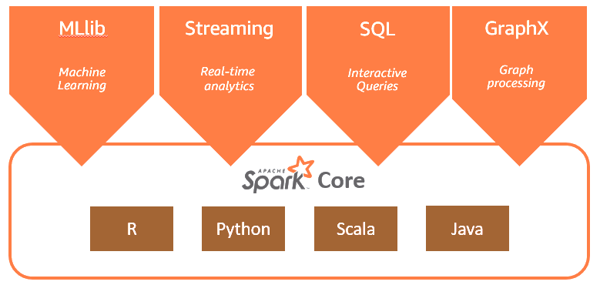
Apache Spark
A large scale distributed data processing engine.
Sits on top of Hadoop YARN and brings the data to memory for faster processing.
Provides real-time stream processing and facilitates distributed machine learning.
https://aws.amazon.com/big-data/what-is-spark/
Data Processing Pipeline
PAGE 11

Slide 12
Data Processing Pipeline Software Stack
Major component of the 5G-Elite architecture.
Provides large scale data processing and visualization.
A platform for deploying ML algorithms for 5G slice orchestration and management.
Data Processing Pipeline
PAGE 12

Slide 13
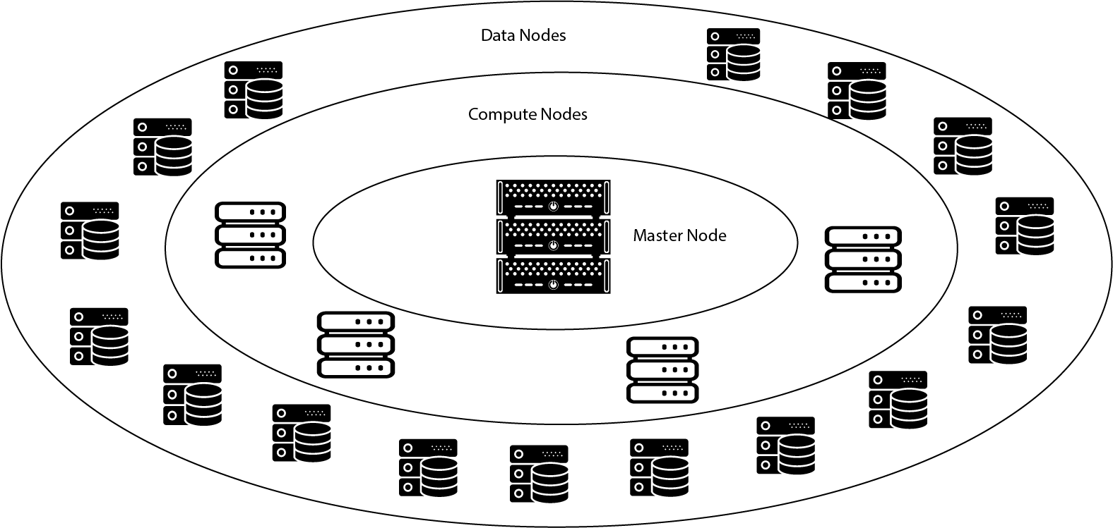
Hardware Infrastructure
16x
4x
~1 Petabyte capacity
Ingesting & processing at TBs/day
>500 x Intel Xeon CPU Cores
~5 TB RAM
GPUs: 2x Tesla V100 1x Tesla P40
Data Processing Pipeline
PAGE 13

Slide 14
Questions?

Slide 15

An Example of Data Flow Through the Pipeline
CPU usage and memory usage collected by Beats at the servers and sent to their respective Kafka topics.
Data Processing Pipeline
PAGE 15

Slide 16
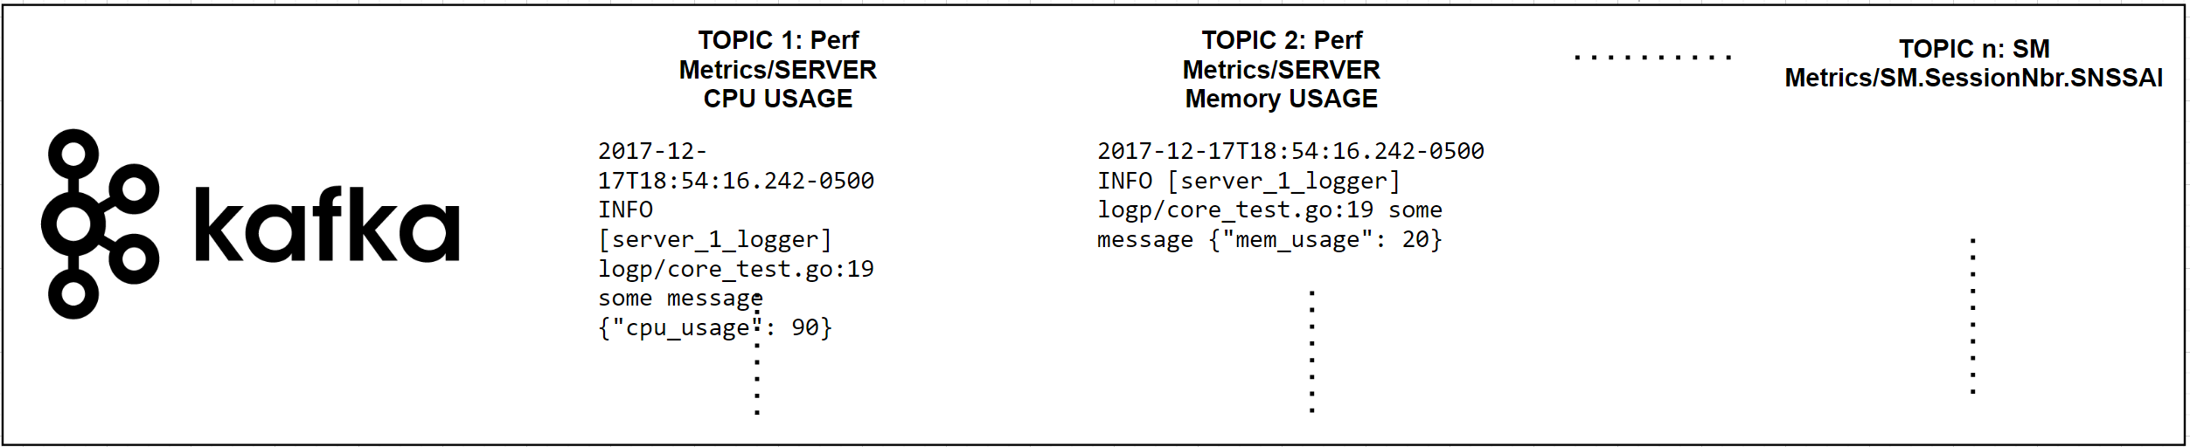
An Example of Data Flow Through the Pipeline
Messages pushed to the Kafka queues and awaiting a consumer.
Data Processing Pipeline
PAGE 16

Slide 17

An Example of Data Flow Through the Pipeline
CPU and memory utilization reports read by Logstash from their respective Kafka topics, cleaned by removing unnecessary information, enriched by adding the timestamp, server id and the location, and then sent to ES to be stored.
Data Processing Pipeline
PAGE 17

Slide 18
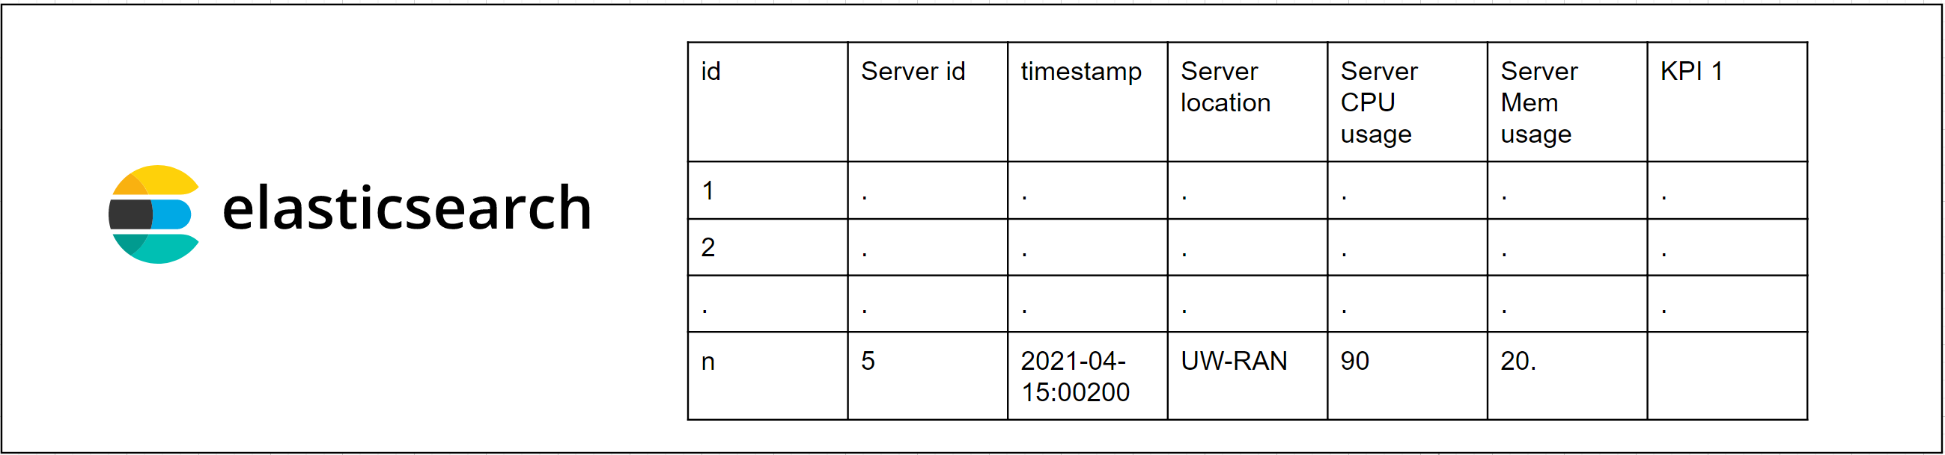
An Example of Data Flow Through the Pipeline
The new information is stored in ElasticSearch and is accessible for further processing.
Data Processing Pipeline
PAGE 18

Slide 19

An Example of Data Flow Through the Pipeline
Data is read from ES by Apache Spark to calculate KPIs, such as average resource utilization. This new information is then sent to ES to be stored alongside the previous data.
Data Processing Pipeline
PAGE 19

Slide 20
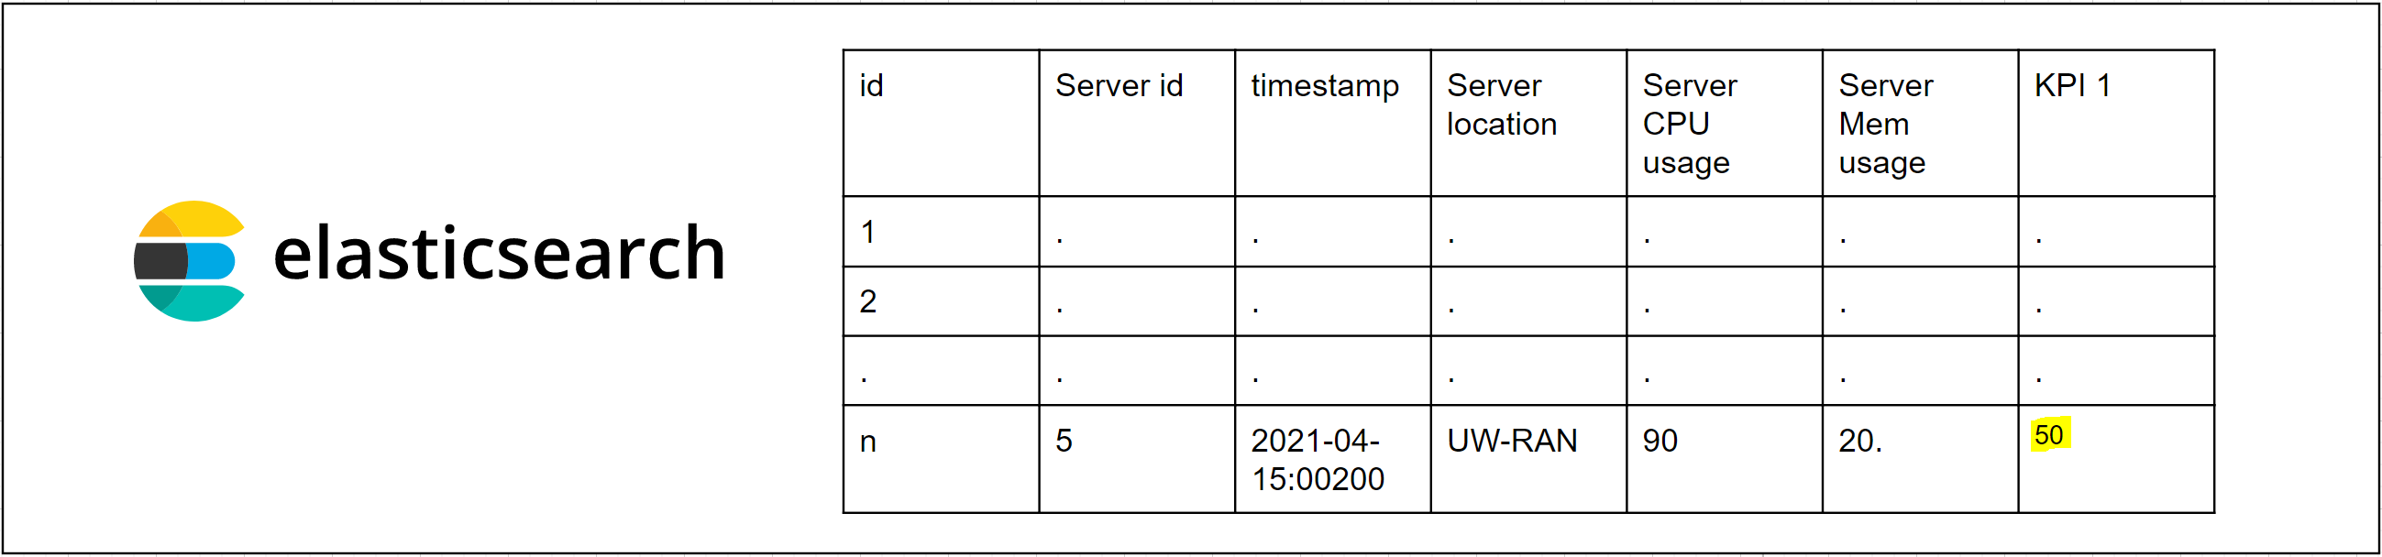
An Example of Data Flow Through the Pipeline
The new information is added to the appropriate rows in ES.
Data Processing Pipeline
PAGE 20

Slide 21
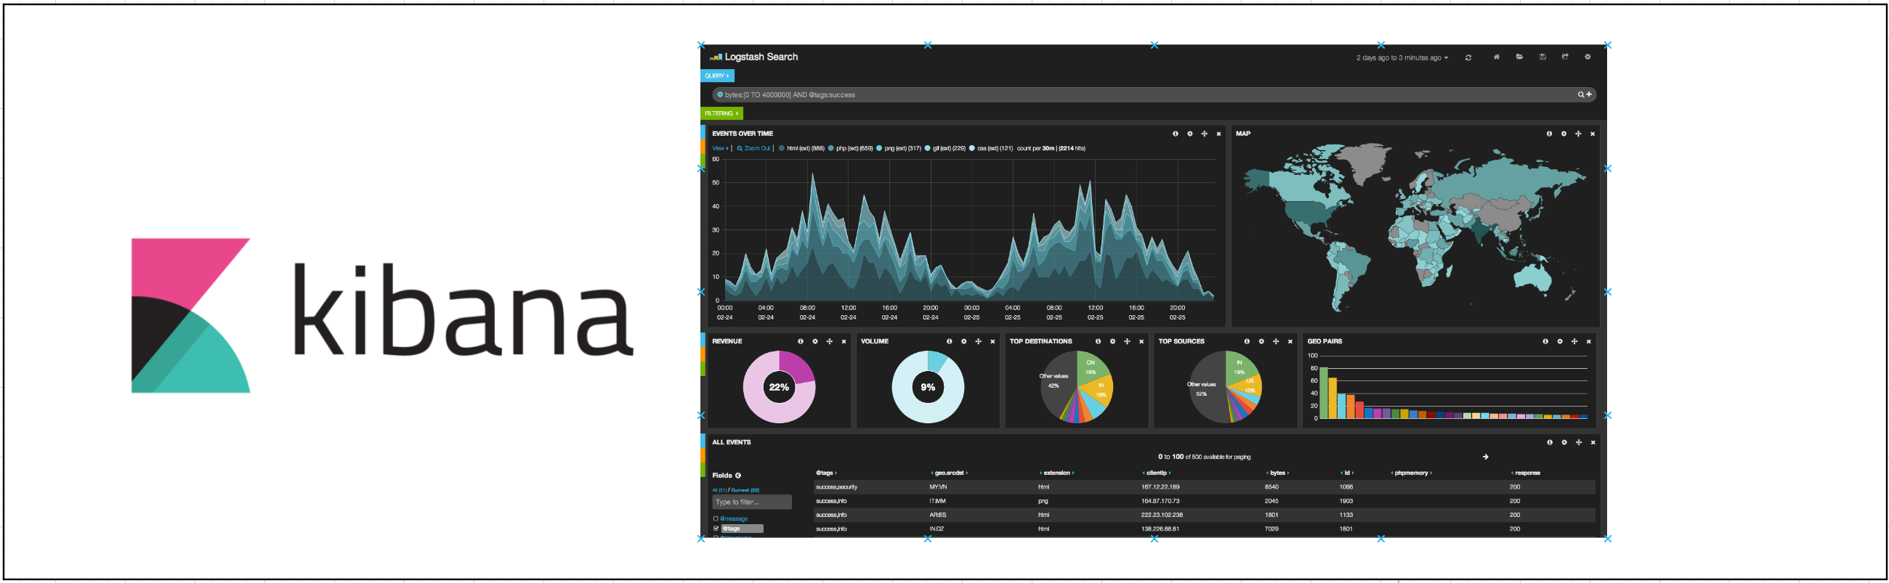
An Example of Data Flow Through the Pipeline
Kibana communicates with ES to provide a visualization of the information, such as the time-series of the resource utilization metric in our example.
Data Processing Pipeline
PAGE 21

